Slide 1
What do our students know?

Slide 2
What do we want our UG students to know?
Student Learning Outcome | Cycle #1 Assessed in: | Cycle #2 Assessed in: | Cycle #3 Assessed in:
Communication Skills
Oral | 2004-2005 | Fall 2008 | Fall 2010
Written | 2005-2006 | Spring 2009 | Fall 2010
Critical Thinking Skills | 2006-2007 | Fall 2009 | Spring 2011
Ethical Reasoning Skills | 2007-2008 | Spring 2010 | Fall 2011
Global Perspective | NA - New in ‘09 | Spring 2010 | Spring 2011
Essential Business Knowledge | Annually | Annually | Annually

Slide 3
What do our UG students know?
ORAL COMMUNICATION SKILLS
Assessed in 2004, 2008, & 2010 from presentations in capstone courses across departments.
UG Committee members were trained and normed then attended classes to observe and rate presentations.
Assessed using the CBA Oral Communication Rubric (Exceeds, Meets, Below Expectations).

Slide 4
What do our UG students know?
ORAL COMMUNICATION SKILLS
Rubric rates on five criteria:
Organization
Voice Quality & Pace
Mannerisms & Body Language
Professionalism & Appearance
Rapport with Audience & Use of Media
Students had the rubric in the course prior to presentations (and hopefully in other courses as well.)

Slide 5
The student will communicate effectively with individuals, teams, and large groups – focus: oral communication.

Slide 6
The student will communicate effectively with individuals, teams, and large groups – focus: oral communication.

Slide 7
What do our UG students know?
WRITTEN COMMUNICATION SKILLS
Assessed using the Writing Proficiency Assessment (WPA).
WPA is assessed on a 12 point scale where 10-12 Exceeds Expectations, 8-9 Meets Expectations, Below 8 falls Below Expectations; Scale equates to the CBA Written Communication Rubric.
Assessed on six criteria:
Content Organization
Audience Style
Mechanics Referencing

Slide 8
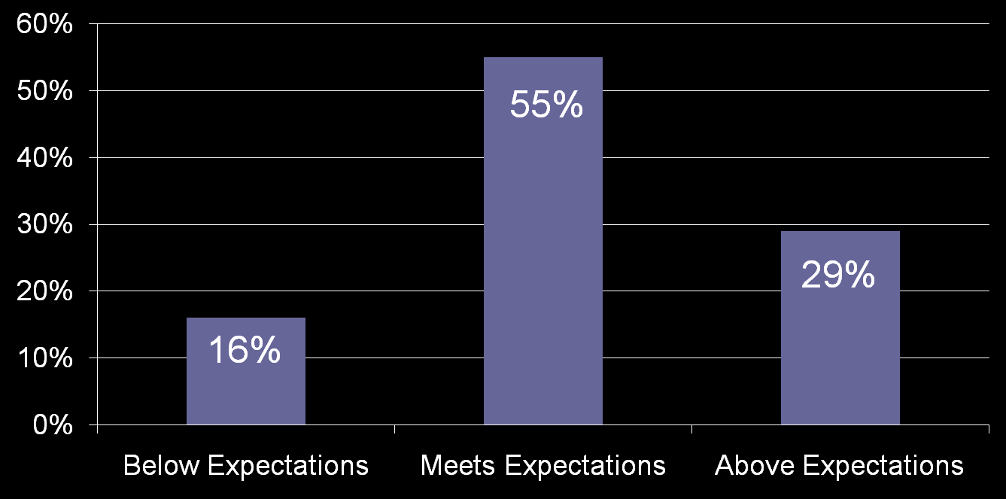
The student will use clear and concise communication in the written form

Slide 9
What do our UG students know?
CRITICAL THINKING SKILLS
Assessed using essay questions from final exam in MGT 405, the college-wide capstone course.
Assessed using a 4 point rubric (Below Expectations, Approaches Expectations, Meets Expectations, Exceeds Expectations).
Assessed on six criteria:
Understands Question/Issue
Use data to illustrate position
Uses models & frameworks
Applies concepts to issues
Thinks strategically
Arrives at logical conclusions

Slide 10
Critical Thinking Skills

Slide 11
What do our UG students know?
ETHICAL REASONING SKILLS
Assessed using embedded questions on final in BA 300 – Ethical Decision Making in Business
SLO #1: Explain the various ethical dimensions of business decision making. (3 Qs)
SLO #2: Explain the role of various affected parties in business decision-making. (3 Qs)
SLO #3: Asses the ethics of decision alternatives using different ethical decision rules. (3 Qs)
SLO #4: apply ethical decision-making rules and concepts. (3 Qs)

Slide 12
Ethical Reasoning Skills

Slide 13
What do our UG students know?
GLOBAL PERSPECTIVE
Assessed using responses to a final exam essay question in MGT 405 (college-wide capstone course)
SLO #1: Identify and describe the impact of the global economy on business decisions.
SLO #2: Explain and apply a global perspective in making business decisions.

Slide 14
Global Perspective

Slide 15
What do our UG students know?
ESSENTIAL BUSINESS KNOWLEDGE
Assessed via the Business Assessment Test (BAT) – 80 Multiple Choice Qs
Administered across the CSU system
Given in MGT 405, the college-wide capstone course
Assesses: Accounting, Business Law, Economics, Finance, Info Systems, Management, Marketing, Statistics

Slide 16
SDSU Longitudinal Comparisons
2008 & after: scores used adjusted scoring that removed 22 items of questionable validity

Slide 17
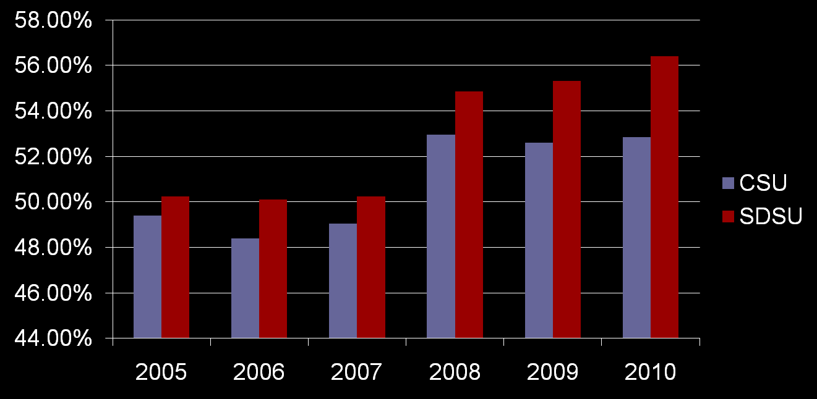
SDSU Longitudinal Comparisons

Slide 18
What do our students know? Summary
Communication Skills
Our students are fairly good oral communicators
Our students are fair writers
Critical Thinking Skills
Our students are fair critical thinkers
Ethical Reasoning Skills
Our students have good ethical reasoning skills
Global Perspective
Our students have somewhat weak global perspectives
Essential Business Knowledge
Our students are generally weak on knowledge of essential business principles

